Slide 1

Cdr. Vijay Pratap Singh, Adjunct Professor, E&TC, TCET

Slide 2

What is HRIS ??
HRIS – Human Resources Information System
It defines as a computer base-application for assembling and processing data related to HR Management functions.
Aids in planning, decision making & submitting of returns and reports to the external agencies.

Slide 3
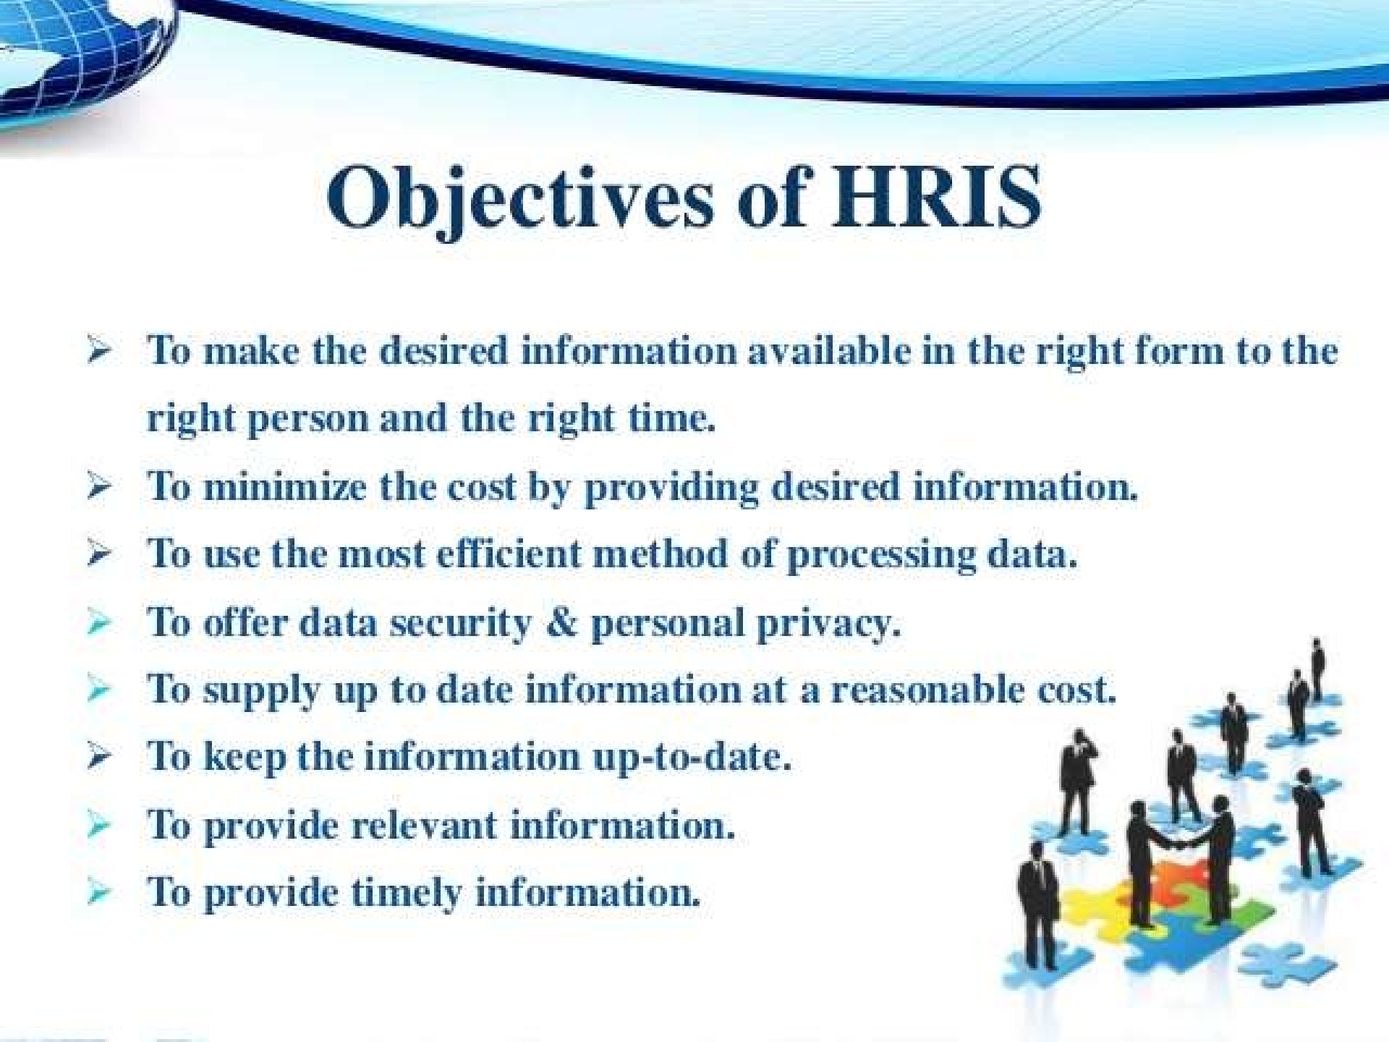

Slide 4


Functions of HRIS
Create and maintain employee record
Ensure legal compliance
Make plan for future HR requirements
Reduce the manual work
Assist manager by providing relevant data

Slide 5

Area of Usage
Personnel administration
Leave/absence recording
Skill inventory
Performance appraisal
Training and development
Human resource planning
Recruitment

Slide 6
Steps of Setting up an HRIS
Planning
Analysis
Design
Implementation
Maintenance
6

Slide 7
HRIS supports in:
The strategic, tactical & operational use of the human resource of an organization
Collect, store and process employee information
Provide reliable information for decision- making
Allow organization to assess effectiveness of HR policies, programs and decisions

Slide 8











Types of HRIS
8

Slide 9





Examples of Tactical HRIS
Job Analysis and Design Information
Systems
Employee Training System
Recruiting Information System
Compensation and benefits information system
9

Slide 10
Examples of Strategic HRIS
Information system supporting Workspace planning
Specialized Human Resource Information Systems Software
10

Slide 11
Examples of Operational HRIS
Performance Management System
1
Employee Information System
2
Applicant Selection and Placement Information System
3
11

Slide 12



Increased efficiency
Increased Effectiveness
More Transactions with fewer resources
More Accurate Information & Simplification Of Process

Slide 13










OSystem itself cannot address and resolve issues within the organization
OSystem breakdown or crashes
OExceeds the costs
OCannot substitute humans

Slide 14

HRIS SOFTWARE
Abra Suite – for HR and payroll management
ABS (Atlas Business Solution ) –Information's of general wages , emergency ,reminders , customer , documents
14

Slide 15

Thank You

